Slide 1
May/June 2021 Financial Report
Board Meeting – May 26, 2021

Slide 2
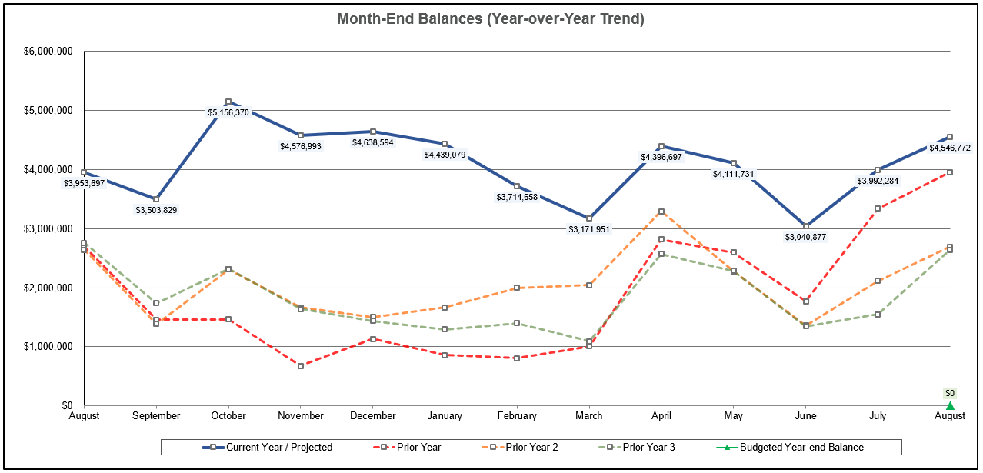
Month-End Fund Balances – Actual and Projected (through 8/31/21)

Slide 3
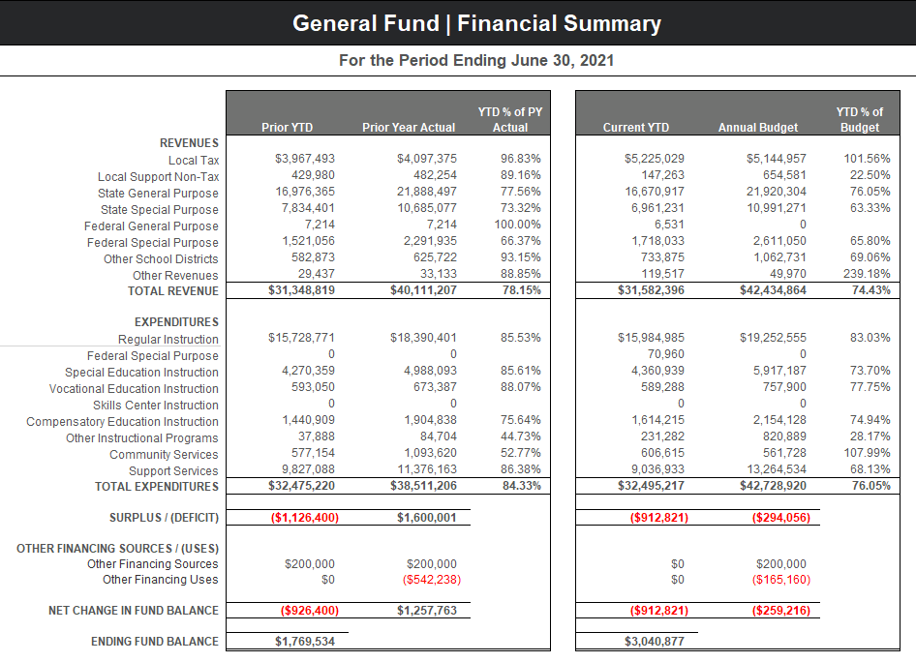
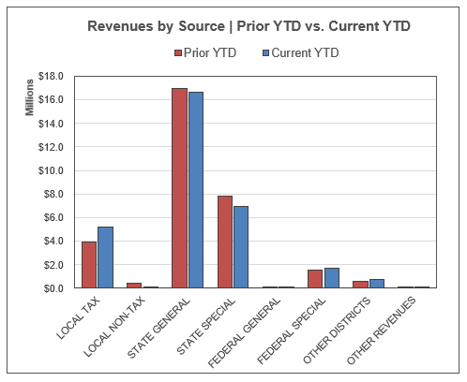
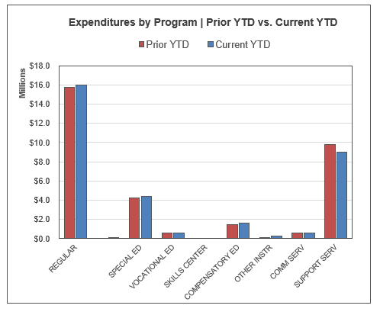
General Fund – Prior YTD and Current YTD Comparison

Slide 4
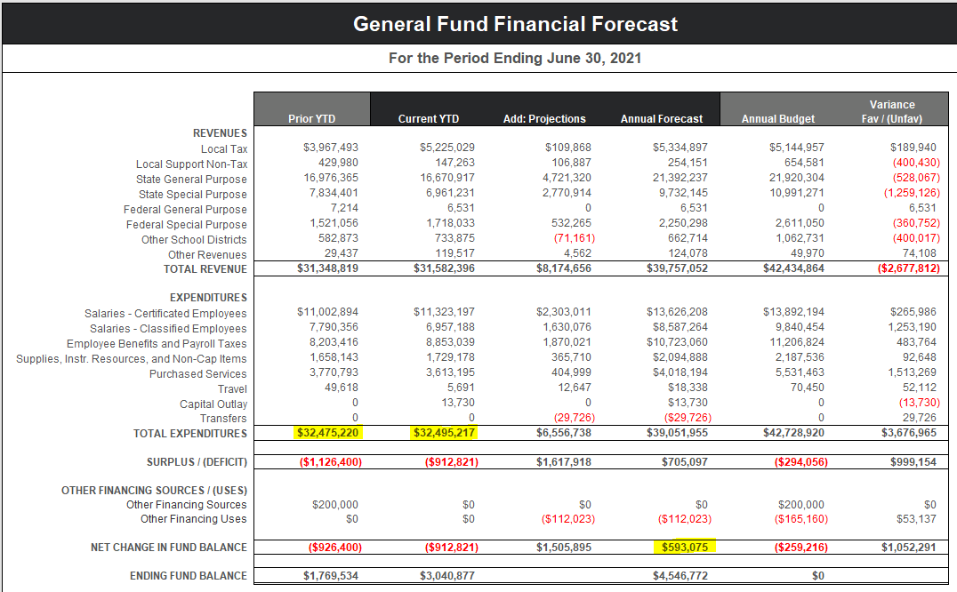
Financial Forecast – Actual thru 6/30/21 and Projections thru 8/31/21

Slide 5
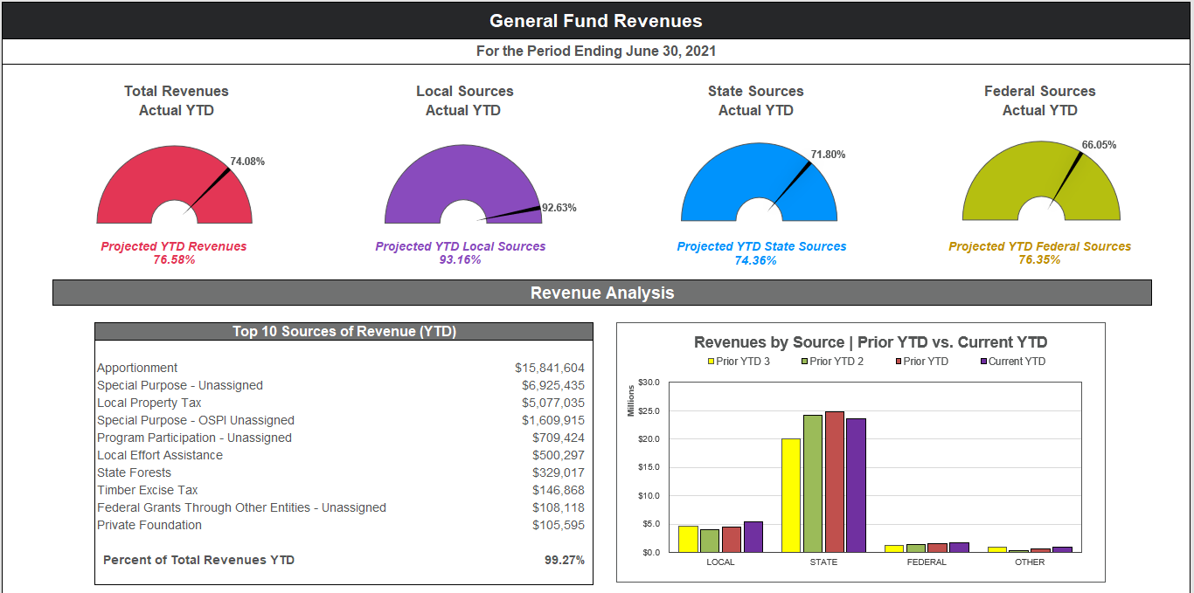
General Fund Revenue Summary

Slide 6
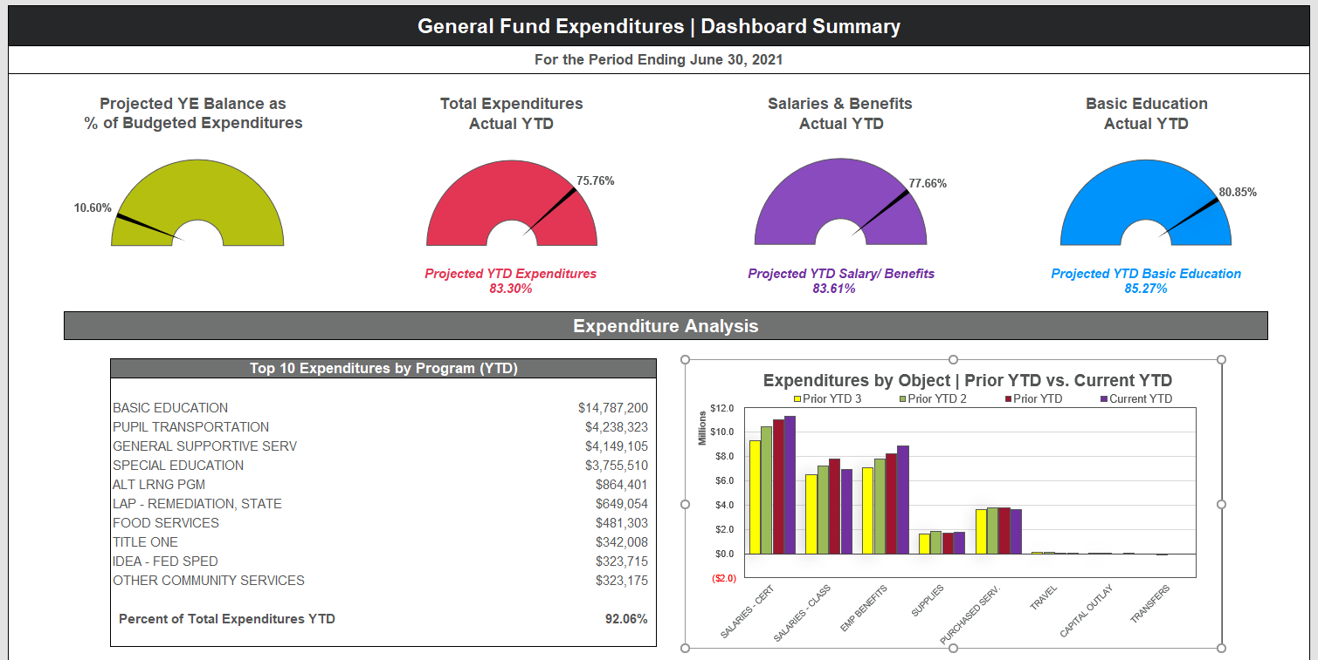
General Fund Expenditure Summary

Slide 7
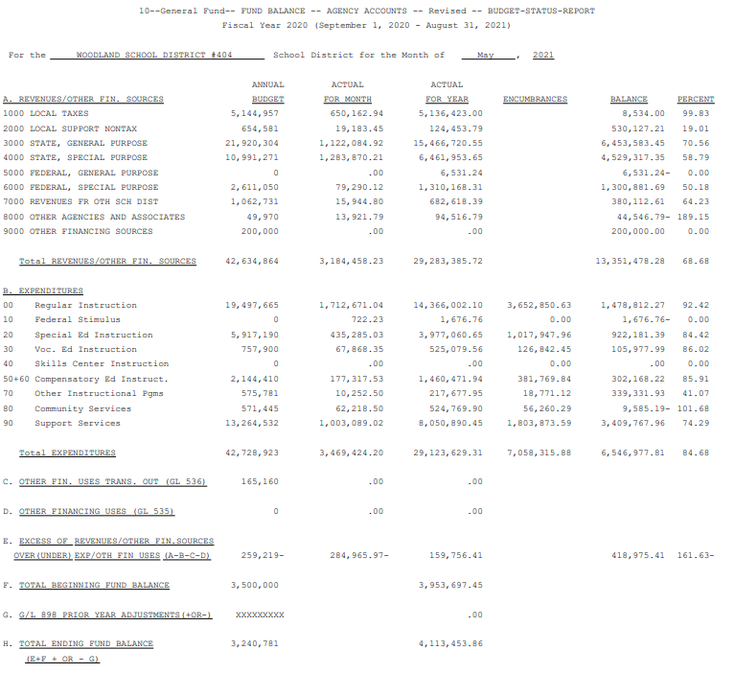
May 2021 Budget Status Report – General Fund

Slide 8
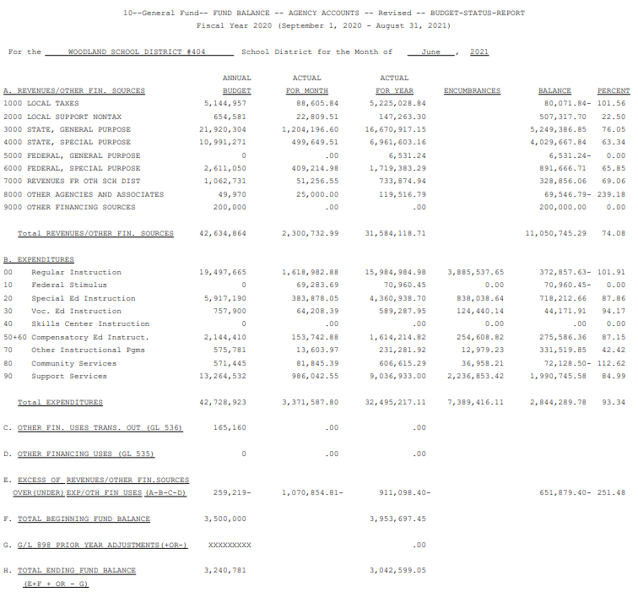
June 2021 Budget Status Report – General Fund

Slide 9
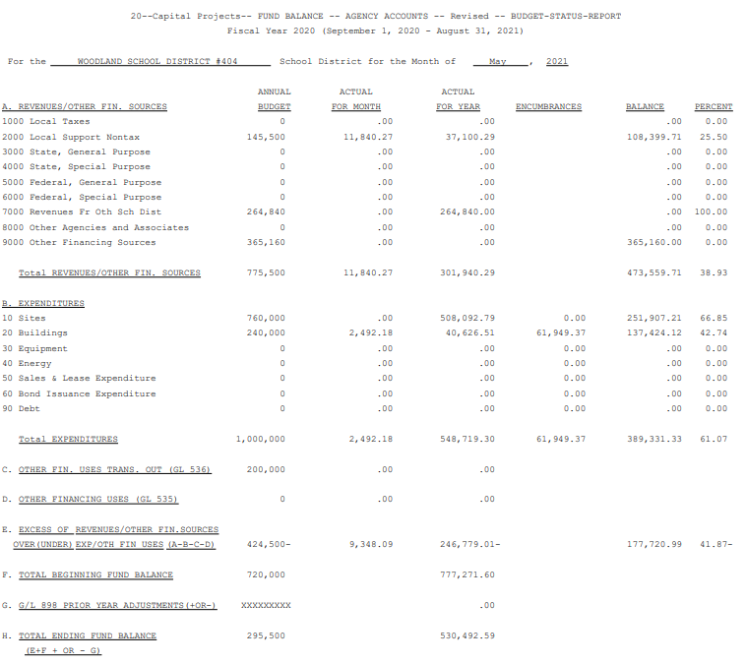
May 2021 Budget Status Report – Capital Projects Fund

Slide 10
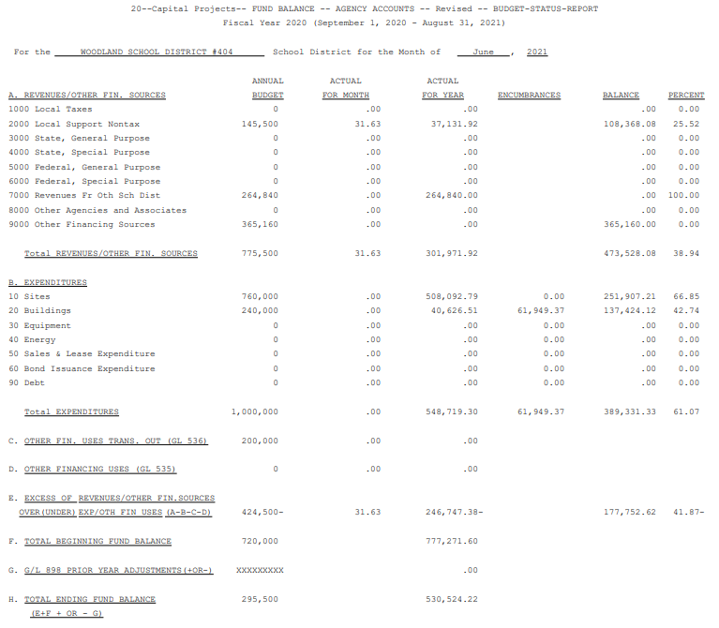
June 2021 Budget Status Report – Capital Projects Fund

Slide 11
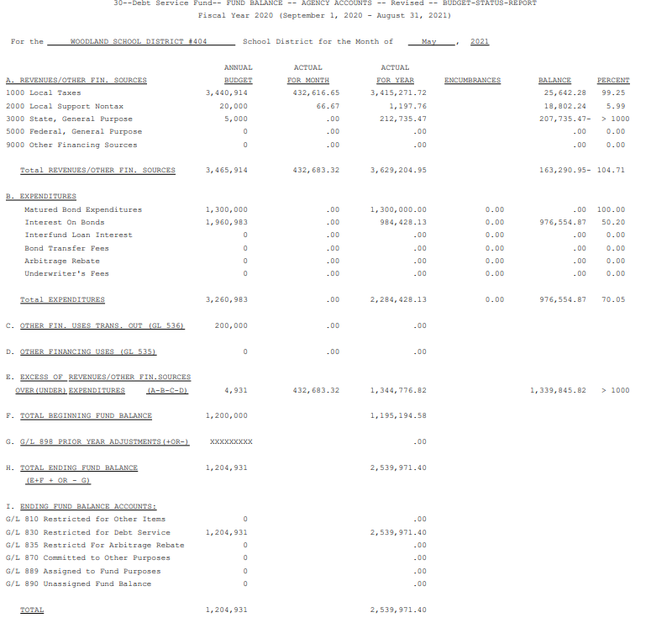
May 2021 Budget Status Report – Debt Service Fund

Slide 12
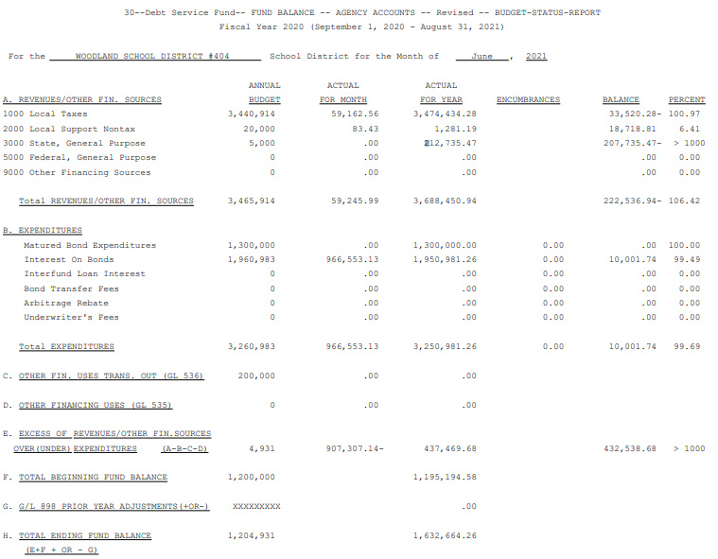
June 2021 Budget Status Report – Debt Service Fund

Slide 13
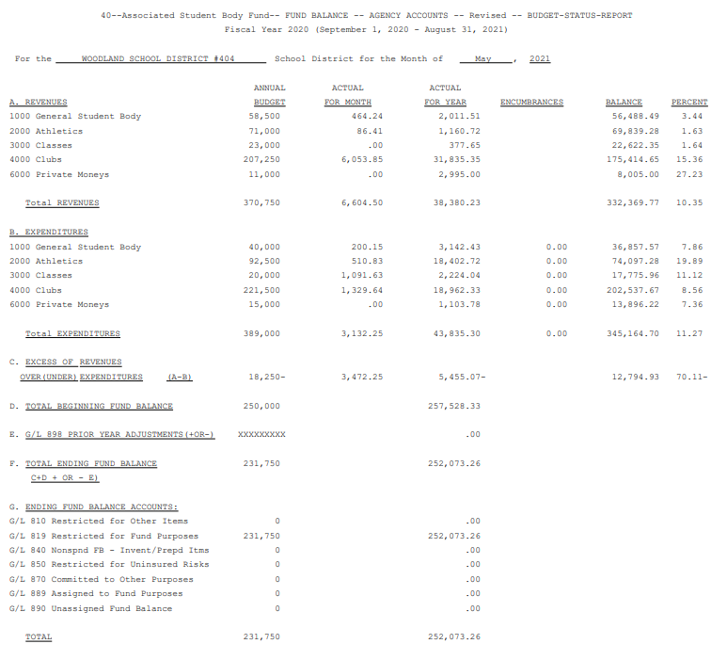
May 2021 Budget Status Report – ASB Fund

Slide 14
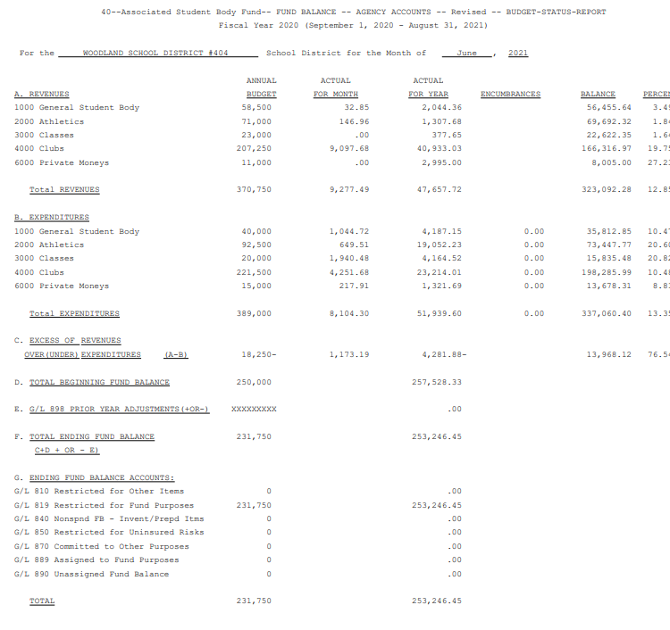
June 2021 Budget Status Report – ASB Fund

Slide 15
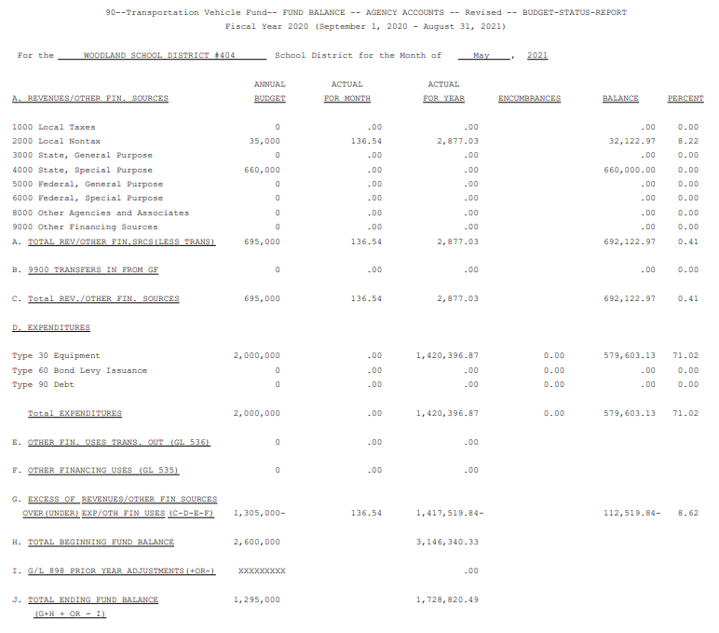
May 2021 Budget Status Report – Transportation Vehicle Fund

Slide 16
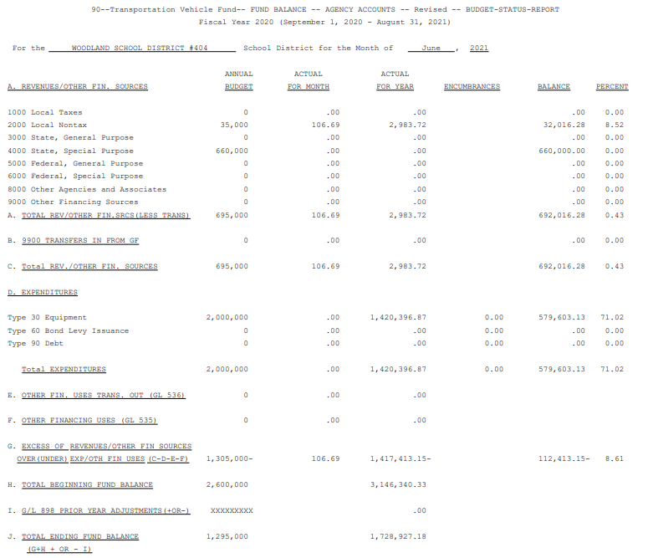
June 2021 Budget Status Report – Transportation Vehicle Fund

